Slide 1
LIFE EVENTS
VOCABULARY REVIEW

Slide 2
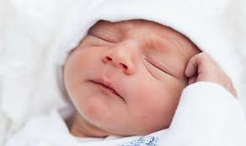
Be born // Was born

Slide 3
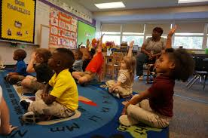
Go to school //
went to school

Slide 4
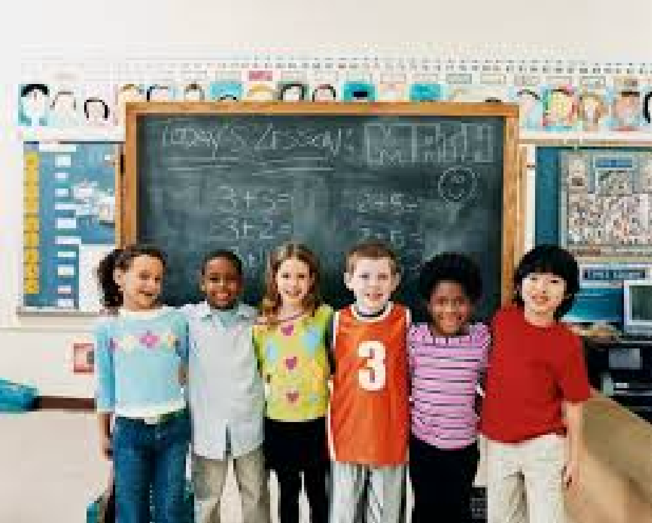
Make friends//Made friends

Slide 5
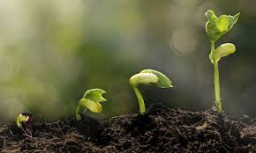
Grow up // grew up

Slide 6
To win an award / a trophy a medal //
won an award/ a trophy/ a medal

Slide 7
Graduate from high School / University //
graduated from high school/ University

Slide 8
Travel abroad//
travelled abroad

Slide 9
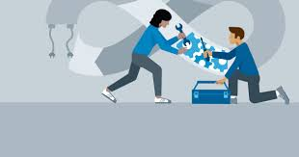
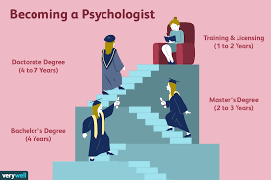
Become a/an+ job //
became a/an+ job

Slide 10
Get a job // got a job

Slide 11
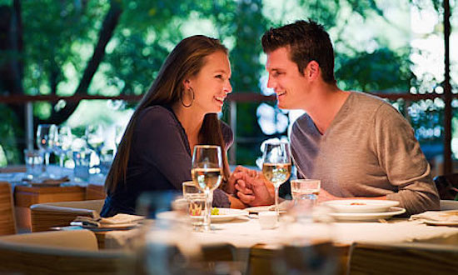
Date // dated

Slide 12
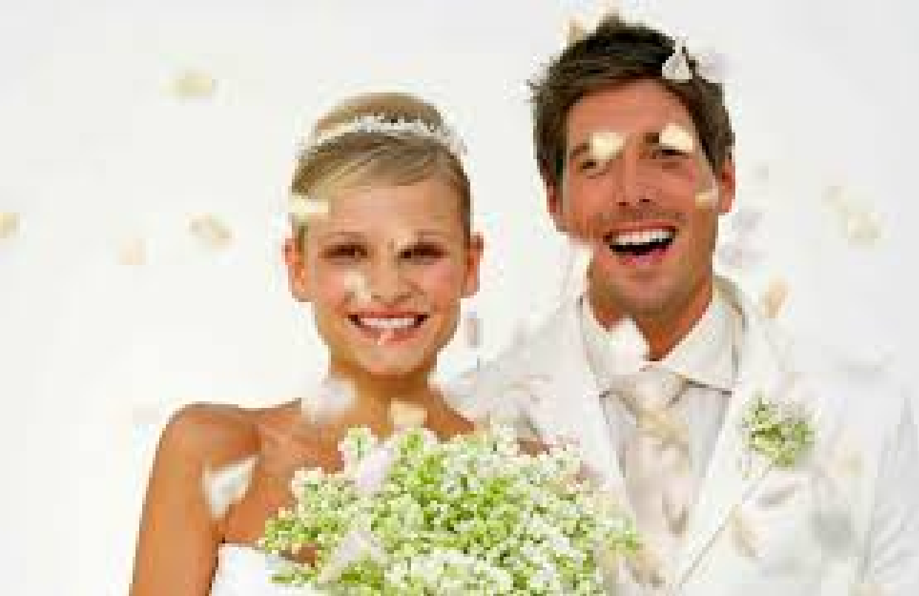
Get married // got married

Slide 13
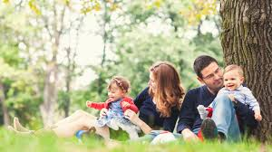
Have children//had children

Slide 14
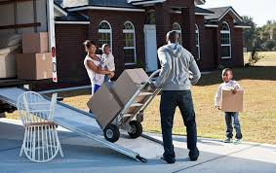
Move to // moved to

Slide 15
Get divorced //
got divorced

Slide 16
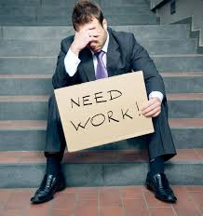
Be unemployed//
was unemployed

Slide 17
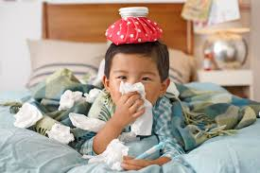
Be sick // was sick

Slide 18
Die //died

Slide 19
PAST TENSE IRREGULAR VERBS
INFINITIVE | PAST TENSE
BE - | I / he /she Was We were
BECOME | I became
GET | I got
GO | I went
GROW | I grew
HAVE | I had
DO | I did
MAKE | I made
WIN | I won

Slide 20
PAST TENSE REGULAR VERBS
INFINITIVE | PAST SIMPLE FORM + ed
DATE | I dated
DIE | I died
MOVE | I moved
TRAVEL | I travelled

